Slide 1
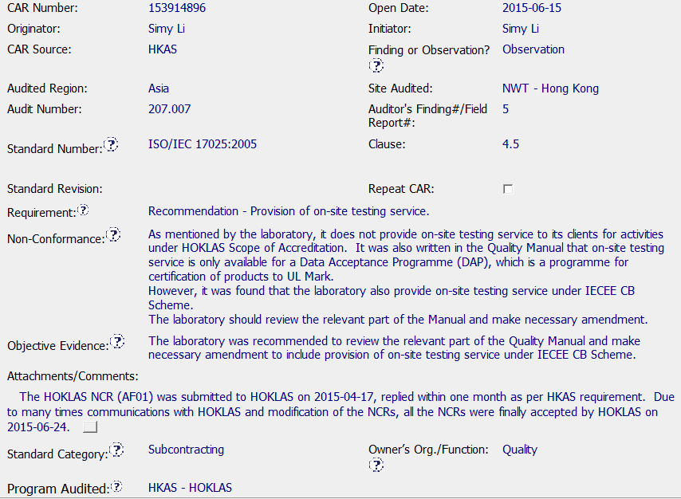
CAR 153914896 - Observation
The information in the Non-Conformance section appears to be more like what I would place in the Objective Evidence section.
Requirement is not clear.
Information in Objective Evidence section appears to be part of the Action Plan.
Evidence that reply to accreditor was submitted by the one month requirement.
Although Subcontracting was picked for the Standard Category, I believe this is a documentation issue.

Slide 2
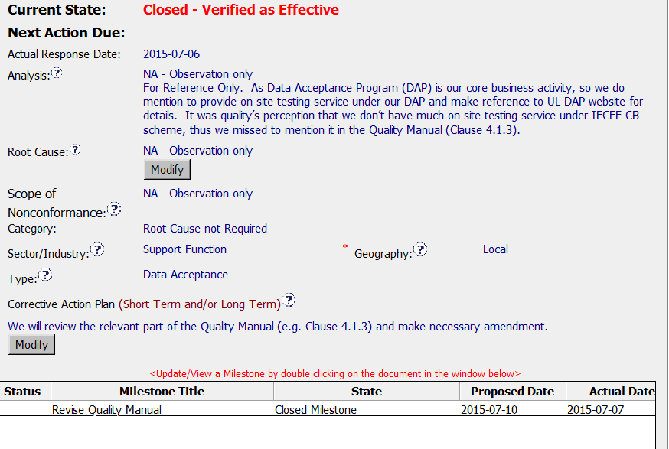
CAR 153914896 - Observation
Action Plan is clear in regard to what part of the Quality Manual they were going to change.
It would have made things clearer if the specifics regarding what was going to be changed were included in the action plan.

Slide 3
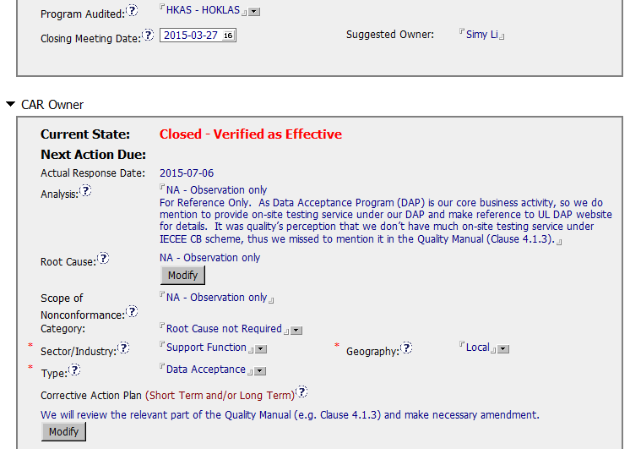
CAR 153914896 - Observation
This CAR would have been easier to follow/understand if information regarding what happened between 3-27 and 7-6 was included.

Slide 4
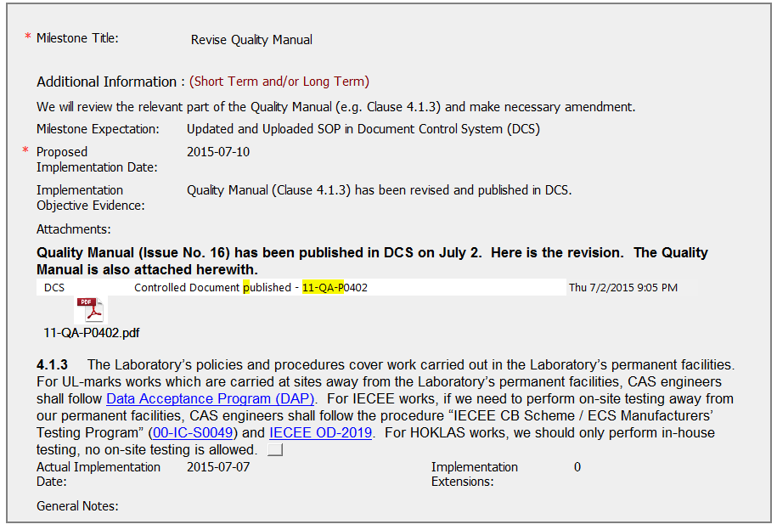
CAR 153914896 - Observation
Document changes and release made ahead of Proposed Implementation Date.
Instructions are clear in regard to DAP, for IECEE work, and for HOKLAS work.

Slide 5
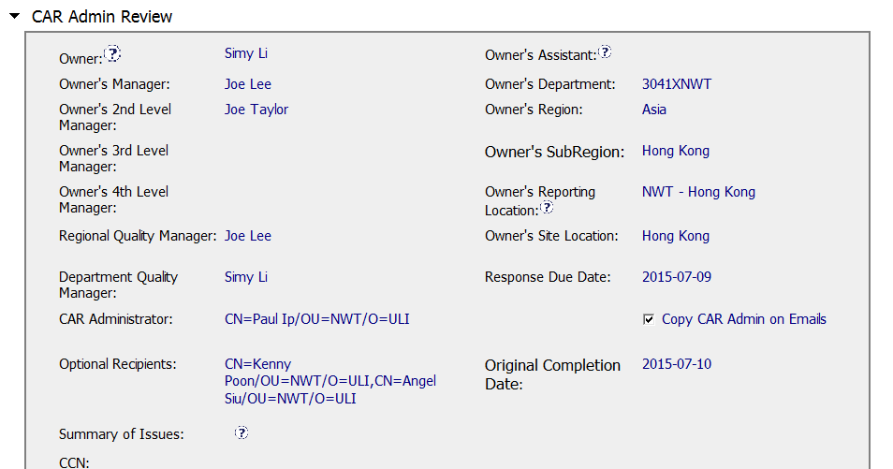
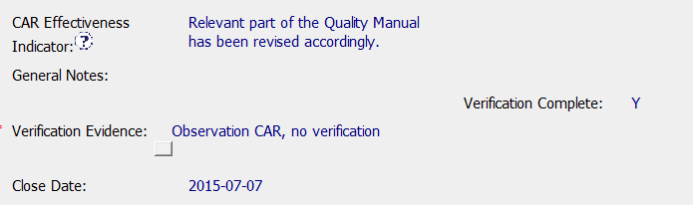
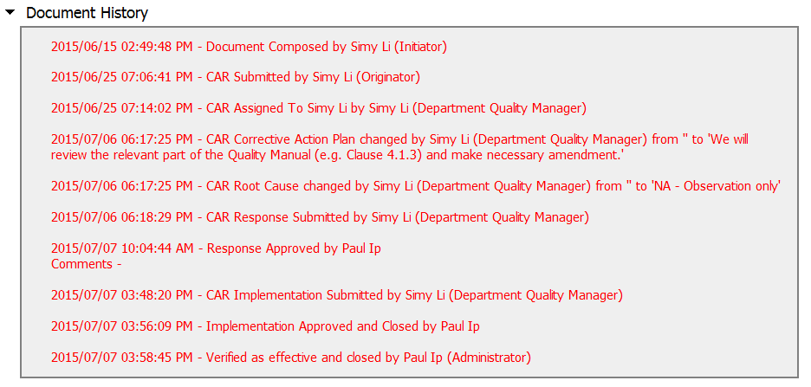
CAR 153914896 - Observation
Closed same day as milestone submission date.
Process appears to flow as expected once it was started.

Slide 6
CAR 153914896 – CBS Check
CBS Requirements | Excellent | Moderate | Need Improve | N/A
INTEGRITY
(C) Extensions are within requirement (<30 days, 3 or less) |  |  |  | X
(T) Most appropriate ‘category’, ‘type’, ‘geography’ are selected | X
(P) Facilitates the handling of disputed CARs |  |  |  | X
(T) Acts on CARs within required timeframe |  | X
COMPETITIVENESS
(C) Analysis shows clear path to root cause and scope; stakeholders identified |  |  |  | X
(C) Root cause statement is succinct, reasonable, complete (Shows ‘N/A’ for observations) | X
(C) Corrective actions fix the objective evidence and other problems found; address entire root cause and scope. For observations, they do not go beyond fixing the objective evidence | X
(C) Milestones address containment & owner’s verification; completed per milestone expectations |  |  |  | X
(P) Verification per requirements | X
COLLABORATION
(L Referenced communications are attached as needed |  |  | X
(C L) Evidence of communication for overdue/escalated CARs and other pertinent concerns |  |  |  | X
(P) Trains other CAR Champions |  |  |  | X

